Slide 1
PROJECTIONS OF POINTS
A point represents a location in space. It is a dimensionless geometrical entity which has simply position but no magnitude. A point is usually represented by a dot or a very small circle.
Projections of points have no practical significance. However, it serves the basis for projections of lines, projections of planes and projections of solids.
POSITIONS OF A POINT
The distances of a point from the HP and the VP are necessary to determine its position in space. We may use parameters (h, d) to indicate the position of the point in space—h indicates the height of the point above/below the HP, d indicates the distance of the point in front of/behind the VP. These parameters may be suffixed by a small alphabet for that point. For example, to indicate the point P in space, parameters (h_{p}, d_{p}) may be used. The space-coordinates h_{p} and d_{p} may be prefixed by a (+) or (–) sign to indicate whether the point is above the HP/in front of the VP or below the HP/behind the VP as illustrated in Fig. 10.1.

Slide 2
The positions of a point may be as follows:
A point in the first quadrant, i.e., above the HP and in front of the VP (e.g., Point A)
A point in the second quadrant, i.e., above the HP and behind the VP (e.g., Point B)
A point in the third quadrant, i.e., below the HP and behind the VP (e.g., Point C)
A point in the fourth quadrant, i.e., below the HP and in front of the VP (e.g. Point D)
A point in the VP and above the HP (e.g. Point E)
A point in the VP and below the HP (e.g. Point F)
A point in the HP and in front of the VP (e.g. Point G)
A point in the HP and behind the VP (e.g. Point H)
A point in both the RPs (e.g. Point I )

Slide 3
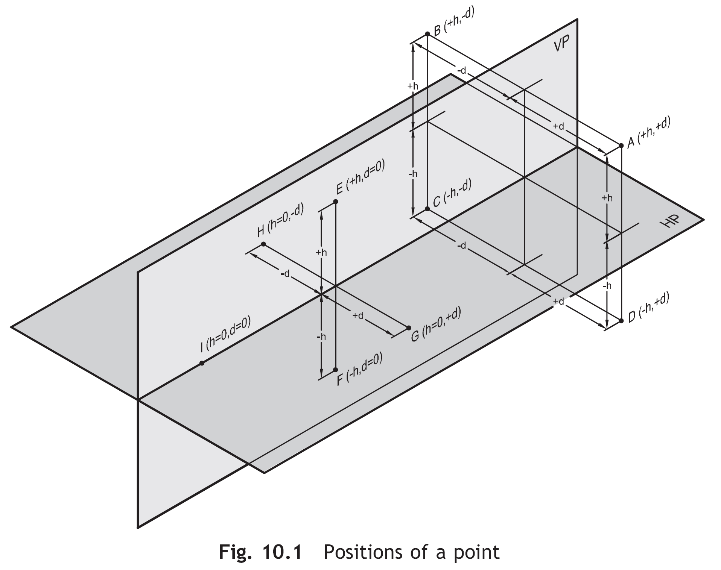

Slide 4
NOTATION SYSTEM
The notations to be followed are as given:
The TV of a point P shall be indicated by p
The FV of a point P shall be indicated by p’
The SV of a point P shall be indicated by p”

Slide 5
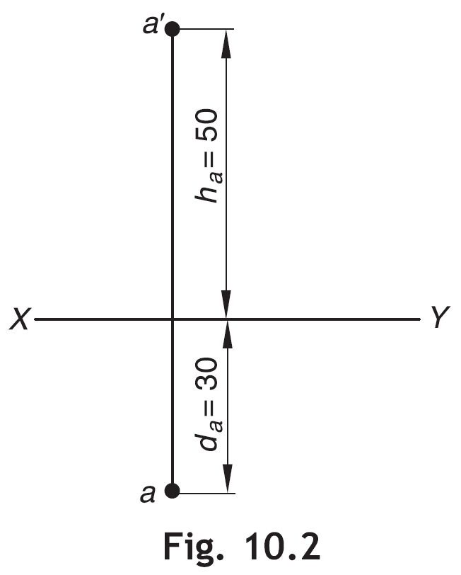
PROJECTIONS OF POINTS: SYSTEMATIC APPROACH
A Point in the First Quadrant
Example 10.1 Draw the projections of the point A which is 50 mm above the HP and 30 mm front of the VP.
Solution Given, h_{a} = +50, d_{a} = +30
Refer Fig. 10.2.
As h_{a} and d_{a} both are (+), the point A is in the first quadrant. Therefore, FV of the point will be seen above XY at a distance of 50 mm and TV will be seen below XY at a distance of 30 mm.

Slide 6
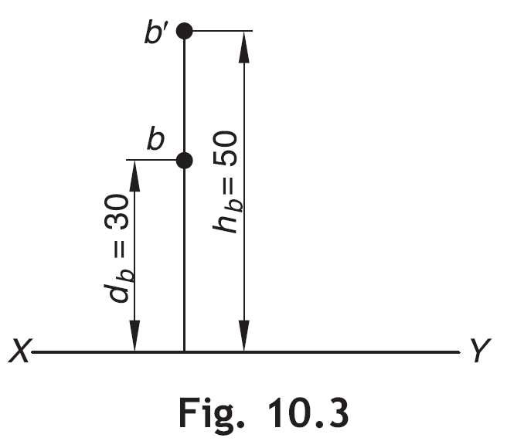
A Point in the Second Quadrant
Example 10.2 Draw the projections of the point B which is 50 mm above the HP and 30 mm behind the VP.
Solution Given, h_{b} = +50, d_{b} = –30
Refer Fig. 10.3.
As h_{b} is (+) and d_{p} is (–), the point B lies in the second quadrant. Therefore, FV and TV, both will be seen above XY at a distance of 50 mm and 30 mm respectively. This is because when the HP is rotated in a clockwise direction about XY, the TV on the HP will go up on the side of the FV.

Slide 7
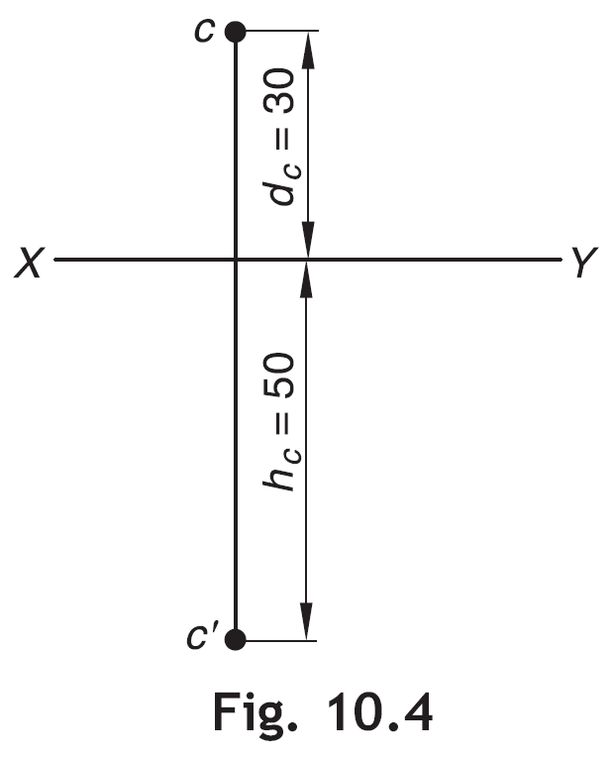
A Point in the Third Quadrant
Example 10.3 Draw the projections of the point C, 50 mm below the HP and 30 mm behind the VP.
Solution Given, h_{c} = –50, d_{c} = –30
Refer Fig. 10.4.
As h_{c} and d_{c} both are (–), the point C is in the third quadrant. Therefore, FV will be seen 50 mm below XY and TV will be seen 30 mm above XY.

Slide 8
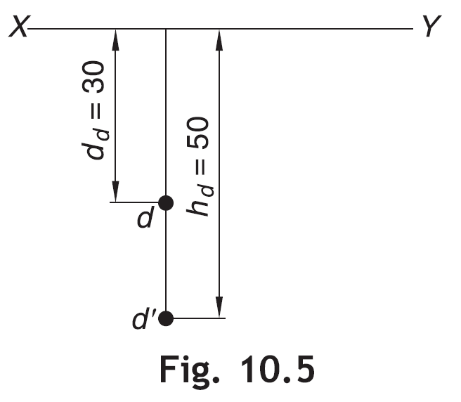
A Point in the Fourth Quadrant
Example 10.4 Draw the projections of the point D which is 50 mm below the HP and 30 mm in front of the VP.
Solution Given, h_{d} = –50, d_{d} = +30
Refer Fig. 10.5.
As h_{d} is (–) and d_{d} is (+), the point D lies in the fourth quadrant. Therefore, FV and TV both will be seen below XY at a distance of 50 mm and 30 mm respectively. When the HP is rotated in a clockwise direction about XY, the TV on the HP will go down on the side of the FV.

Slide 9
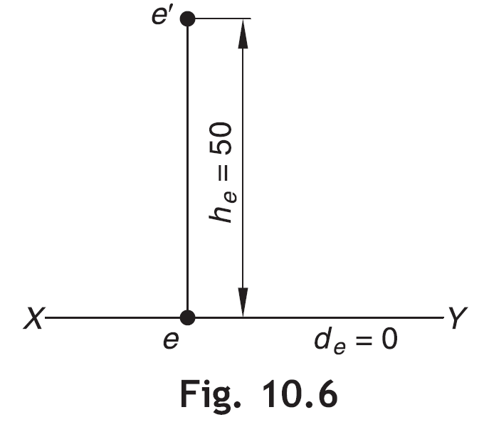
A Point in the VP and Above the HP
Example 10.5 Draw the projections of the point E in the VP and 50 mm above the HP.
Solution Given, h_{e} = +50, d_{e} = 0
Refer Fig. 10.6.
As h_{e} = +50, FV will be seen above XY. As d_{e} = 0, TV will be seen on XY.

Slide 10
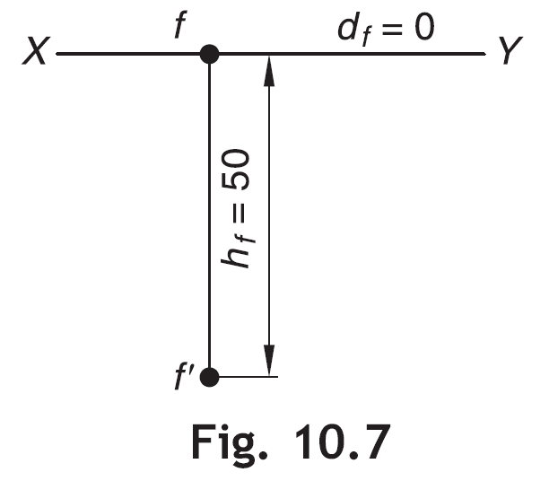
A Point in the VP and Below the HP
Example 10.6 Draw the projections of the point F in the VP and 50 mm below the HP.
Solution Given, h_{f} = –50, d_{f} = 0
Refer Fig. 10.7.
As d_{f} = 0, TV will be seen on XY. As h_{f} = –50, FV will be seen 50 mm below XY.

Slide 11
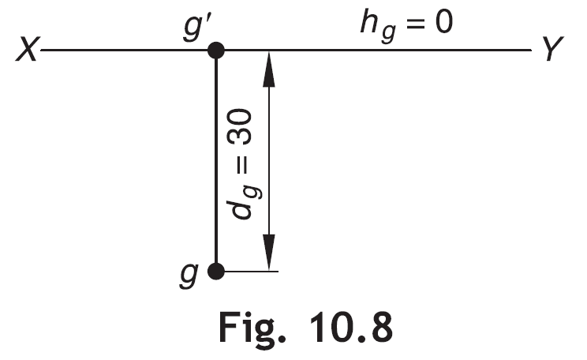
A Point in the HP and in Front of the VP
Example 10.7 Draw the projections of the point G which is in the HP and 30 mm in front of the VP.
Solution Given, h_{g} = 0, d_{g} = +30
Refer Fig. 10.8.
As h_{g} = 0, FV will be seen on XY. As d_{g} = +30, TV will be seen 30 mm below XY.

Slide 12
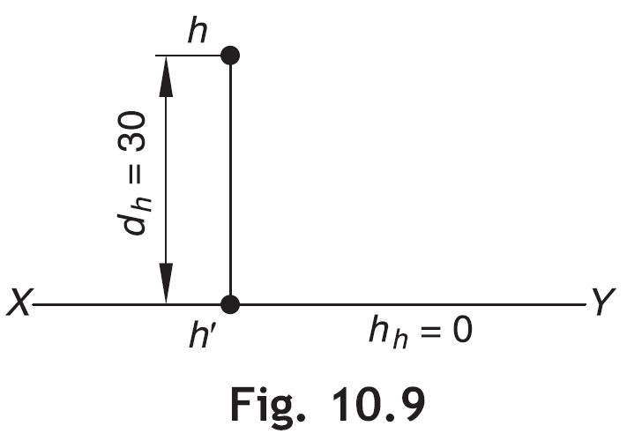
A Point in the HP and Behind the VP
Example 10.8 Draw the projections of the point H which is in the HP and 30 mm behind the VP.
Solution Given, h_{h} = 0, d_{h} = –30
Refer Fig. 10.9.
As h_{h} = 0, FV will be seen on XY. As d_{h} = –30, TV will be seen 30 mm above XY.

Slide 13
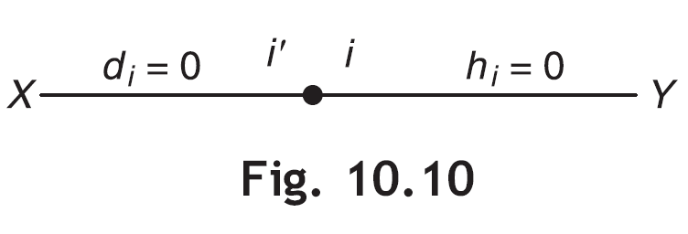
A Point in Both the RPs
Example 10.9 Draw the projections of the point I which lies in both the RPs.
Solution Given, h_{i} = 0, d_{i} = 0
Refer Fig. 10.10.
If the point I lies in both the RPs then it lies at the intersection of the two RPs, i.e., on XY. Hence, its FV and TV both will coincide on XY.

Slide 14
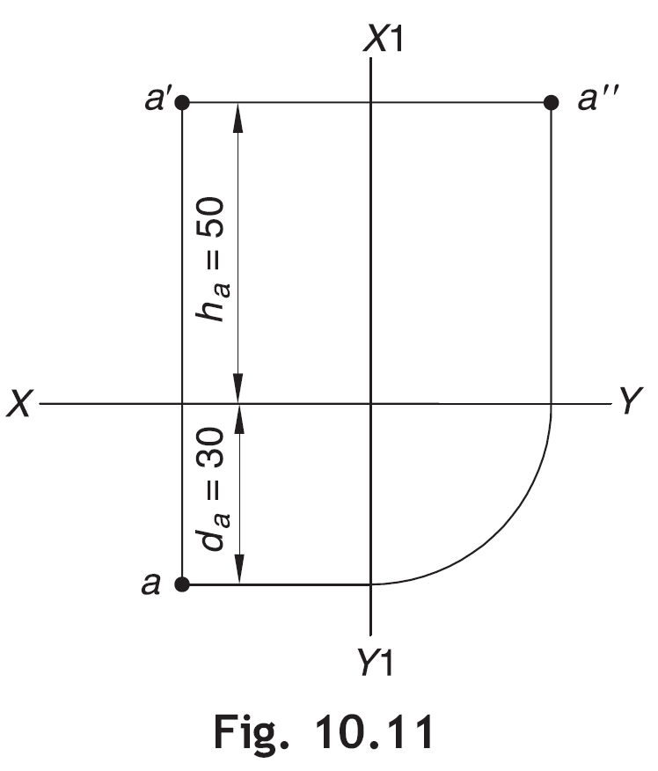
SV OF THE POINT
The SV of the point is obtained by projecting the FV and TV with respect to X1Y1 as explained in the following examples.
Example 10.10 Draw the LHSV of the point A mentioned in Example 10.1.
Solution The LHSV of the point is shown in Fig. 10.11. As already mentioned in the previous chapter, SV is always drawn to the side of FV. Here, the LHSV of the point is drawn to the right side of FV, because the point is in first quadrant. X1 Y1 may be taken arbitrarily at any suitable distance from FV and TV.

